Slide 1
Some thoughts about energy storage modelling in power systems
David Howey and Volkan Kumtepeli
DIGEST Meeting
March 2023

Slide 2
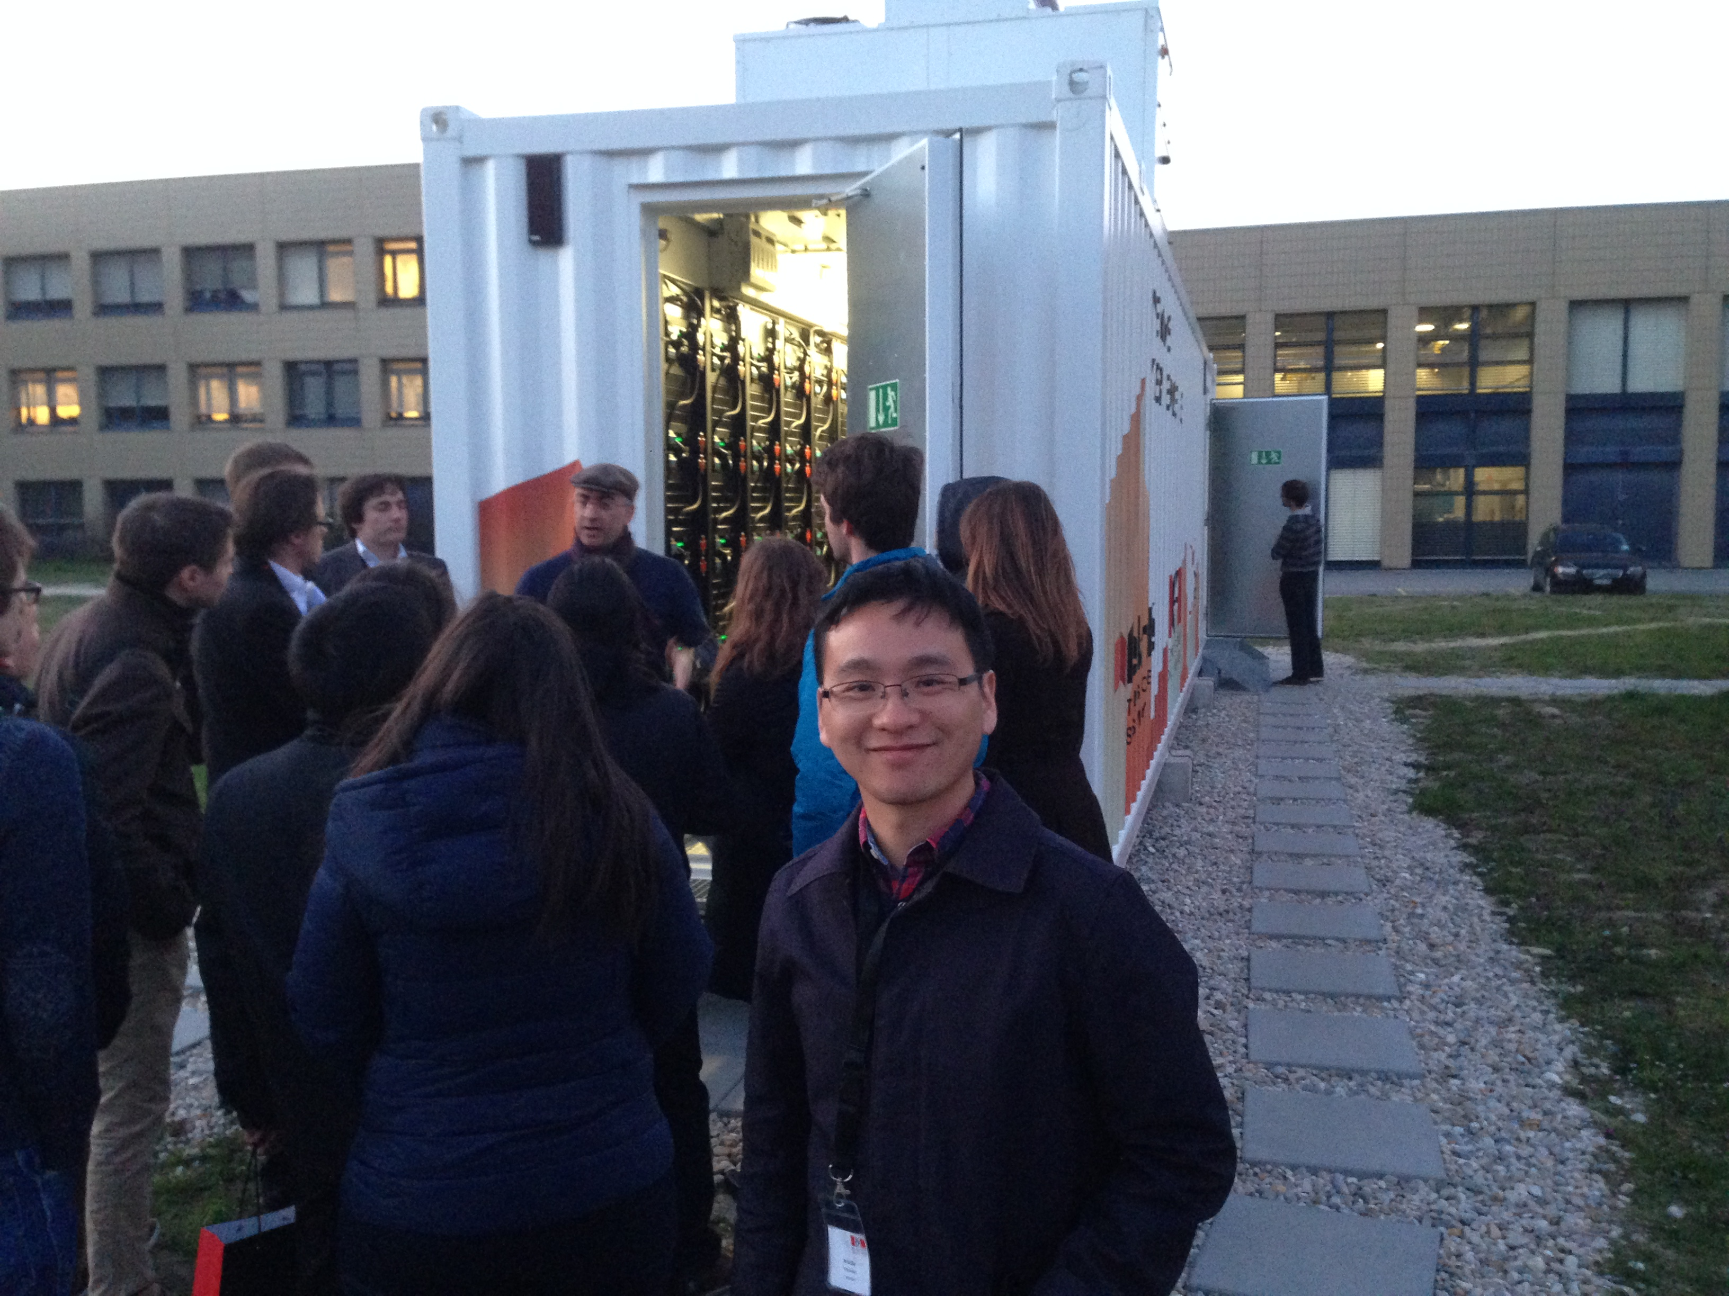

Why should power engineers care about batteries?
According to Aurora Energy Research*:
1 GW of batteries contracted in UK via capacity market to date
50% of “frequency containment reserve” in Germany covered by batteries in 2018
400 MW batteries deployed 2016-18 in the US
China targets 7 million EVs by 2025
Like it or not, batteries are here, and to control them correctly we need to understand their:
Dynamics
Thermal behaviour
Degradation characteristics

Slide 3
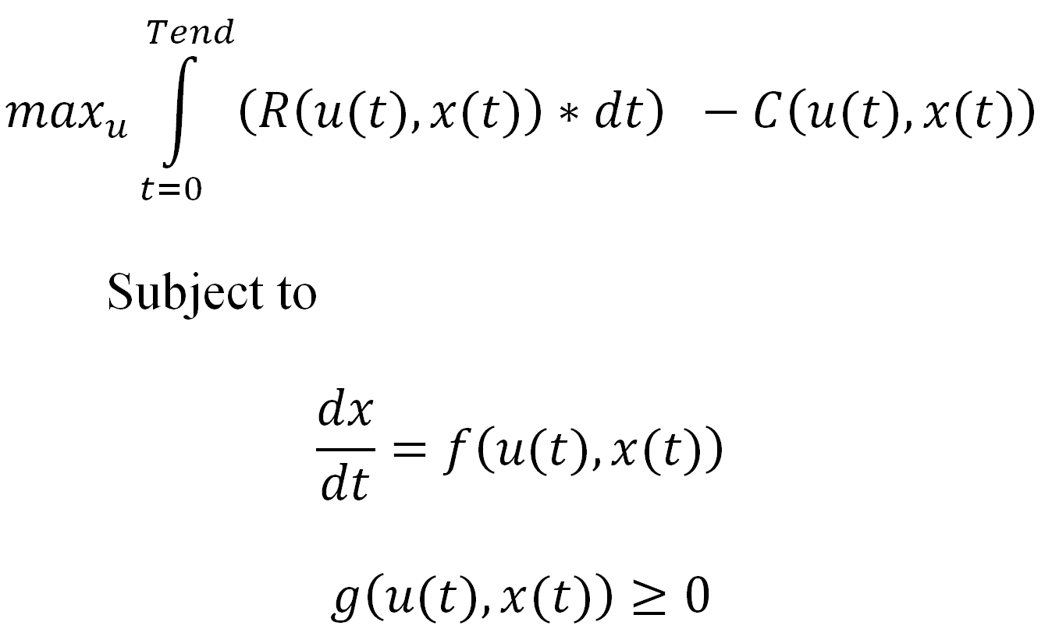
Why should power engineers care about batteries?
Model fidelity (maybe) matters. Example: optimally control a grid battery to maximise profit on wholesale arbitrage market:
here is ‘the battery
model’
If one assumes the battery is just a simple “bucket for energy”, one may under-estimate the revenue and the costs. Using a more nuanced dynamic battery model including degradation here almost doubles the profit, in our calculations, but is complex.

Slide 4
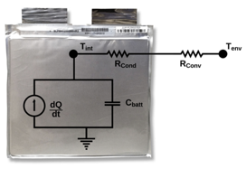
Battery modelling – why is it useful?
Design (cell, pack)
How to predict behaviour of a new
chemistry
How do I design electrodes
How much heat will my cell produce
How do I design a balancing system
How do I match cells within a pack
Estimation (e.g. BMS, VSC)
State of charge (SOC)
Temperature
State of health (SOH)
Power capability
System integration & control (e.g. EMS, VSC)
What is the efficiency map
What is the optimal (dis)charge profile
How long will the batteries last
What voltages will the inverter see

Slide 5
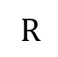
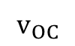
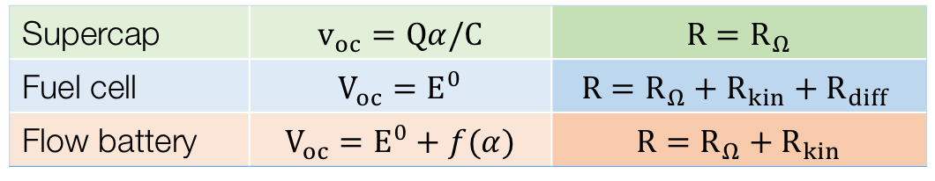
Electrochemical devices are all similar
Electrically, in all electrochemical devices (supercaps, fuel cells, flow batteries) there is a voltage source, and there are losses*.
Batteries (e.g. li-ion) are similar, but exhibit transport limitations:
$$R$$
$$v_{OC}$$
$$−$$
$$+$$
Supercap | $$v_{oc}=Qα/C$$ | $$R=R_{Ω}$$
Fuel cell | $$V_{oc}=E^{0}$$ | $$R=R_{Ω}+R_{kin}+R_{diff}$$
Flow battery | $$V_{oc}=E^{0}+f(α)$$ | $$R=R_{Ω}+R_{kin}$$
Battery | $$V_{oc}=E^{0}+f(α)$$ | $$R=R_{Ω}+R_{kin}+R_{diff}$$
SOC
ohmic kinetics diffusion
* Ignoring, in this simple model, additional dynamics, and ignoring mechanical losses

Slide 6
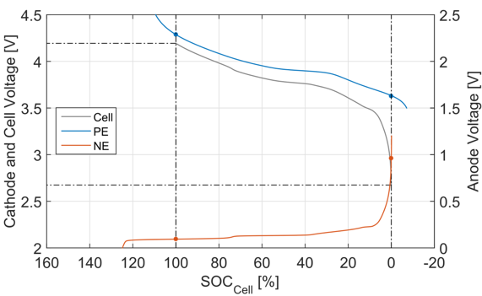
Understanding state of charge in lithium-ion
Cell SOC must be defined against cell open circuit voltage.
Cell OCV is a combination of positive & negative electrode OCV.
Voltage limits are established against each electrode.
These dictate the cell OCV min/max, and hence SOC min/max.
cell V_{max}
+ve electrode
establishes V_{max}
-ve electrode
establishes V_{min}
cell V_{min}
SOC max (full charge)
SOC min (full discharge)

Slide 7
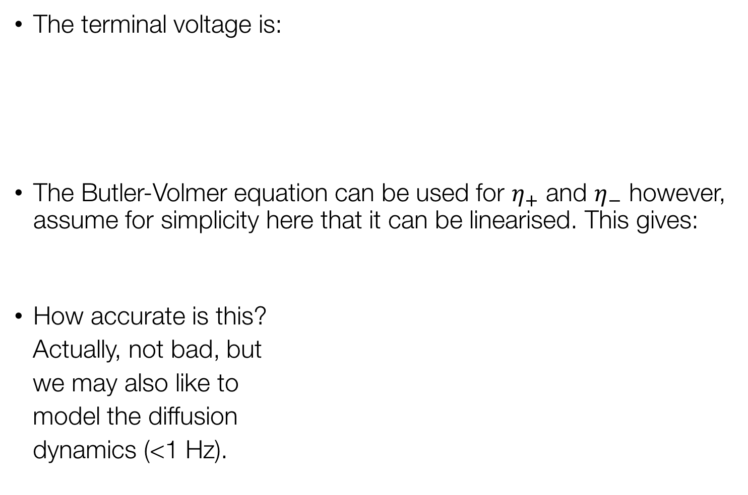
A basic battery model: voltage source + resistor(s)
The terminal voltage is:
The Butler-Volmer equation can be used for $η_{+}$ and $η_{−}$ however, assume for simplicity here that it can be linearised. This gives:
How accurate is this?
Actually, not bad, but
we may also like to
model the diffusion
dynamics (<1 Hz).
OCV of each electrode (nonlinear function of SOC)
overpotential of each electrode (i.e. kinetics)
ohmic/ionic losses

Slide 8
Battery packs may be modelled in a similar manner
So far we have only discussed cell modelling. However most larger systems (EV, grid) include 100s-10000s of cells to form a pack. How do we model this? There are two extremes:
Model the entire pack as if it’s one big cell.
Model every cell in the pack
A compromise is to model every (sub)-module as if it was a cell.
In practice ECMs are almost exclusively used for option 1 since they represent average behaviour (could be significant cell-to-cell variations in the pack).
$$−$$
$$+$$
$$−$$
$$+$$
$$−$$
$$+$$
$$−$$
$$+$$
In series connected systems, the equivalent cell model has a resistance and voltage that is the sum of the underlying models:
$$V_{total}=∑V_{i}$$
$$R_{total}=∑R_{i}$$
$$−$$
$$+$$
In parallel connected systems:
$$V_{total}=V_{i}$$
$$R_{total}=1/(∑{\frac{1}{R}}_{i})$$
$$−$$
$$+$$
$$−$$
$$+$$
$$−$$
$$+$$

Slide 9
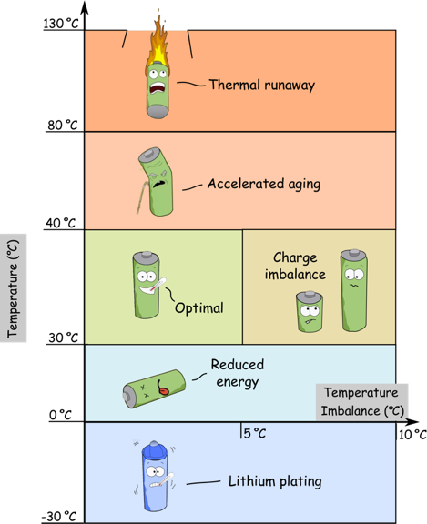
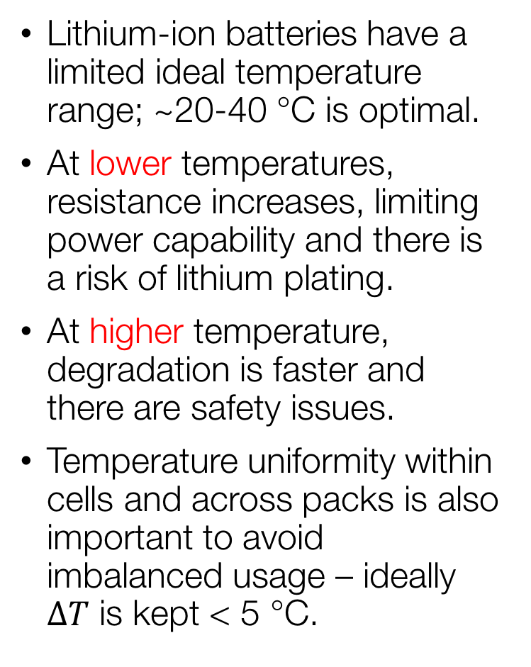
Thermal management is important for devices
Lithium-ion batteries have a limited ideal temperature range; ~20-40 ℃ is optimal.
At lower temperatures, resistance increases, limiting power capability and there is a risk of lithium plating.
At higher temperature, degradation is faster and there are safety issues.
Temperature uniformity within cells and across packs is also important to avoid imbalanced usage – ideally $ΔT$ is kept < 5 ℃.

Slide 10
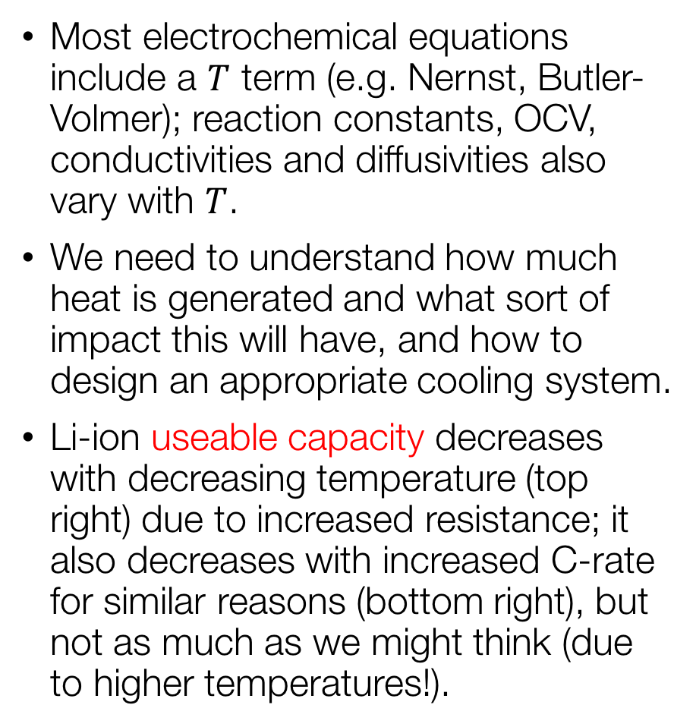
Temperature strongly impacts performance
Most electrochemical equations include a $T$ term (e.g. Nernst, Butler-Volmer); reaction constants, OCV, conductivities and diffusivities also vary with $T$.
We need to understand how much heat is generated and what sort of impact this will have, and how to design an appropriate cooling system.
Li-ion useable capacity decreases with decreasing temperature (top right) due to increased resistance; it also decreases with increased C-rate for similar reasons (bottom right), but not as much as we might think (due to higher temperatures!).

Slide 11
Lithium-ion batteries degrade with time and use
Gradual degradation is thought to be caused by build up of negative electrode “solid electrolyte interphase” (SEI) and particle fragmentation. Internal short circuits are also a concern.
Copper dissolution and dendrite formation
Solvent co-intercalation and graphite exfoliation
Transition metal dissolution and
dendrite formation
Structural disordering
Aluminium
corrosion and contact loss
SEI
Carbon
Anode
Cathode
Li⁺
Copper current collector
Binder
Binder
Separator
Aluminium current collector
Binder de-composition and contact loss
Copper cracking
and contact loss
Particle
cracking
Particle cracking,
SEI formation
and build-up
Cathodic
surface film
Lithium plating and dendrite formation
Internal short-circuit
SEI decomposition
and precipitation

Slide 12
Degradation depends on SOC, temperature..
Calender ageing Cycle ageing
Data: Mat4Bat project, Reniers, Howey et al. J Power Sources 379:91-102, 2017

Slide 13


Degradation impacts arbitrage revenue using EES

Slide 14
Discussion points
What energy storage systems should be considered? (possibilities: Li-ion, pumped hydro, flow battery, liquid air, supercaps, [flywheels?])
What are the key energy storage parameters required?
Two of these: Capacity (MWh), power rating (MW), duration (h)
Efficiency (charge/discharge) – or losses
Degradation cost
What cost function(s) do we want to optimize against? (how much do we care about optimal sizing vs. optimal control)
How should one (de)couple the ‘long term’ investment question (e.g. 30 years horizon) with the short term decision making. (This is really a question of how to cost degradation correctly in the short term – short term decisions may impact degradation cost)
What price data to use?

Slide 15
Background stuff

Slide 16
Lithium-ion: intercalation within host electrodes
Lithium-ion batteries are different to most other batteries; the solid electrodes change composition through intercalation, where Li⁺ is inserted reversibly between the electrode layers.
There is (ideally) no involvement of the solvent in normal cycling.
Positive electrode (3.5–4.5 V vs. Li)
C
D
Li⁺
Negative electrode (0.1–1.3 V vs. Li)
Li⁺
C
D
Full cell (2.7–4.2 V vs. Li)
Above: Intercalation of lithium ions into a graphite electrode
(image: wikimedia commons, public domain)
x, y are SOC of + and - electrodes
Note: other cathode materials available
Notes:
X = fractional occupancy of sites in the lattice

Slide 17
There are a range of electrode materials available
Graphite: most common negative material (Li₂TiO₃ also used)
Various lithium-metal-oxide positive materials are used:
graphite negative electrode (SEM)
x1500 mag
Cathode materials | Nominal cell volts (V) | Energy density (Wh/kg) | Power density (kW/kg)
LiCoO₂ (LCO) | 3.8 | 80-150 | < 0.5
LiMn₂O₄ (LMO) | 3.8 | 150-180 | < 2
LiNiCoAlO₂ (NCA) | 3.8 | 100-130 | < 1.1
LiNiMnCoO₂ (NMC) | 3.8 | 125-200 | < 1.2
LiFePO₄ (LFP) | 3.3 | 50-130 | < 2
NCA positive electrode (SEM)
x1500 mag

Slide 18
Electrolyte and current collectors need to be stable
The electrolyte in a li-ion cell includes a:
Solvent, which is a non-aqueous organic liquid or polymer because of the reactivity of water with lithium,
Solute, made up of lithium salt e.g. LiPF₆, LiBF₄ or LiClO₄.
One reason for the upper voltage limit is to avoid oxidation of the electrolyte.
The current collectors are:
Aluminium is used at the positive electrode since it is stable at high potential although reacts with lithium below 0.6 V (vs. Li).
Copper is used at the negative electrode (but it oxidises at > 3.2 V vs. Li causing impurities to enter the electrolyte).
Inside a lithium-ion cell – lithiated electrode material
Here’s what happen to my old iphone when left uncharged for months.
Image: Wikimedia commons by Mpt-Matthew, CC BY-SA 3.0 licence.

Slide 19
Batteries are all about the open circuit voltage (OCV)
Often overlooked, OCV in fact usually dominates the voltage response!
Voltage drops due to internal resistances generally quite small by comparison
Galvanostatic intermittent titration test (GITT) is used to measure open circuit voltage
Small (dis)charge, then a long rest period for cell to relax.
Another technique is “pseudo-OCV” measurement, which is a very low C-rate (discharge) e.g. C/24

Slide 20
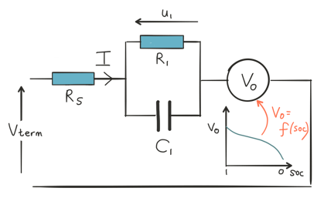
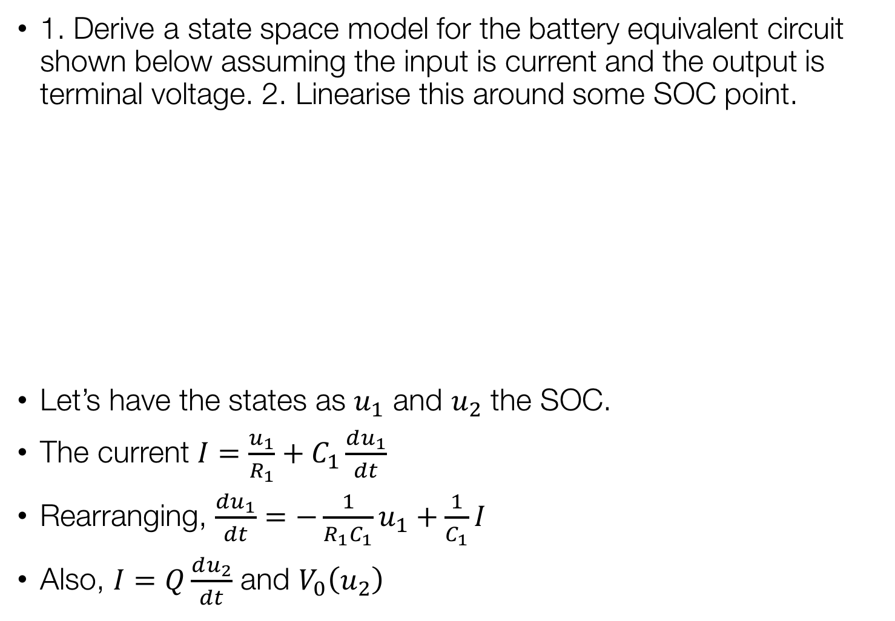
Worked example: Equivalent circuit model
1. Derive a state space model for the battery equivalent circuit shown below assuming the input is current and the output is terminal voltage. 2. Linearise this around some SOC point.
Let’s have the states as $u_{1}$ and $u_{2}$ the SOC.
The current $I=\frac{u_{1}}{R_{1}}+C_{1}\frac{du_{1}}{dt}$
Rearranging, $\frac{du_{1}}{dt}=−\frac{1}{R_{1}C_{1}}u_{1}+\frac{1}{C_{1}}I$
Also, $I=Q\frac{du_{2}}{dt}$ and $V_{0}\left(u_{2}\right)$

Slide 21
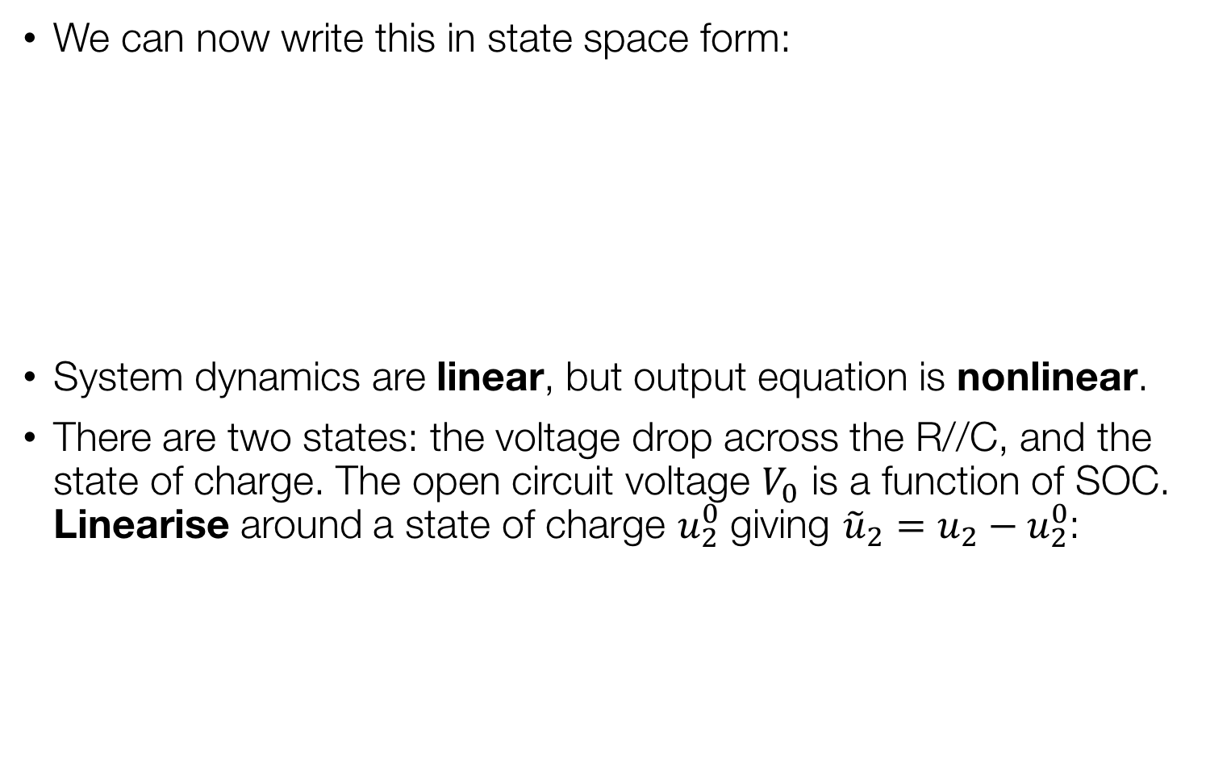
Worked example: Equivalent circuit model
We can now write this in state space form:
System dynamics are linear, but output equation is nonlinear.
There are two states: the voltage drop across the R//C, and the state of charge. The open circuit voltage $V_{0}$ is a function of SOC. Linearise around a state of charge $u_{2}^{0}$ giving ${\tilde{u}}_{2}=u_{2}−u_{2}^{0}$:
SOC
capacity
D
A
B
linearised OCV
C

Slide 22
This models diffusion dynamics reasonably well
Observe the battery continuing to generate heat even after the high current pulse is stopped.
voltage
“relaxation”
iR drop

Slide 23
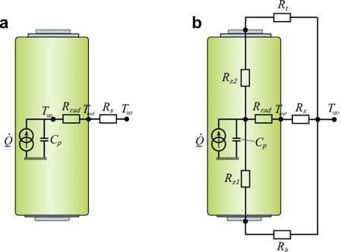
Thermal equivalent circuits (TECs) are a useful tool
Although there are neat techniques for achieving very low order solutions to the PDE problem, a common approach for thermal modelling is thermal equivalent circuits.
These are “0D” models – heat generation typically lumped into one average term. The idea is similar to the ECMs we used before – but applied to the heat equation.
Averaged internal temperature of cell
We have: $\dot{Q}=$ current source (heat); $C_{p}=mc_{p}$, capacitance; $R_{rad}=\ln{\frac{\left({r_{o}}/{r_{i}}\right)}{2k_{r}πL}}$ and $R_{z}=\frac{L}{2k_{z}πR^{2}}$, equivalent radial and axial resistances, fitted; $R_{s},R_{t}=1/hA$, equivalent convection resistances

